Slide 1
Global Gender Data
Sarah Read and Cis Xing

Slide 2
Data Overview
UN Statistics and Indicators on Women and Men
23 data sets and about 200 countries
Population, Health, Family, Education, Work, Politics
Additional attributes:
Region
Economic growth
Twitter Data

Slide 3
Analysis
Interested in:
Education differences between genders and between regions
Health data
Family data
Correlation between gender equality and economic growth
Data manipulation:
Merge Population, Health, Family, and Education data sets into respective groups
Add additional attributes

Slide 4
Types of Analyses
Visualizations
Bar charts
Maps
Clustering
Predictions
KNN
Regression
Decision Trees

Slide 5
Cleaning the data
Merge into 4 data sets
Remove rows with missing data
Match country names to map names
Add labels

Slide 6
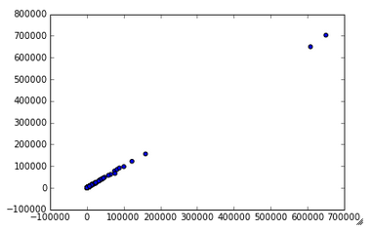
Population Visualization
Male Population vs. Female Population

Slide 7
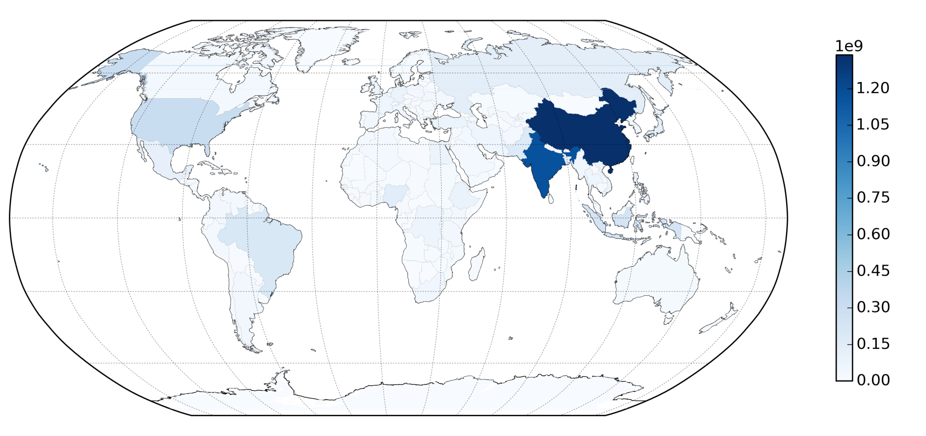
Population Map

Slide 8
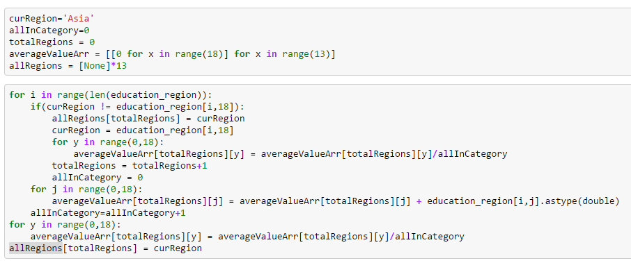
Creating Visualizations by Region
Create an array that holds the average of all of the data:

Slide 9
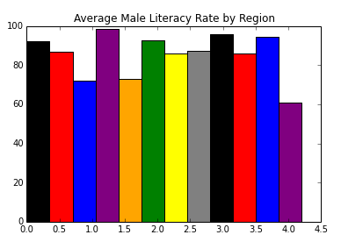
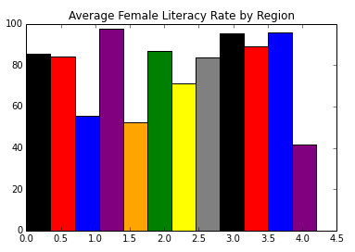
Education by Region
Western Africa
The Caribbean
Central America
Oceania
Central America
Southern Africa
Asia
Northern Africa
South America
Middle Africa
South America
The Caribbean
Eastern Africa
Oceania
Middle East
Southern Africa
Western Africa
Northern Africa
Europe
Asia
Eastern Africa
Middle East
Middle Africa
Europe

Slide 10
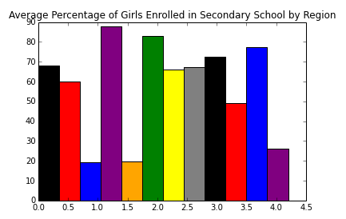
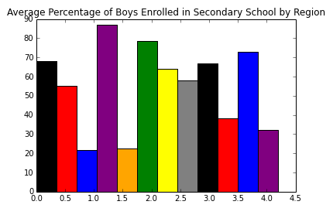
Education by Region
Central America
Western Africa
Middle Africa
Western Africa
Eastern Africa
Eastern Africa
Western Africa
Middle Africa
Eastern Africa
Middle Africa
Southern Africa
Central America
The Caribbean
Asia
The Caribbean
The Caribbean
South America
Middle East
Southern Africa
Central America
South America
Middle East
Asia
Southern Africa
Europe
Oceania
Asia
South America
Northern Africa
Europe
Oceania
Northern Africa
Middle East
Oceania
Northern Africa
Europe

Slide 11
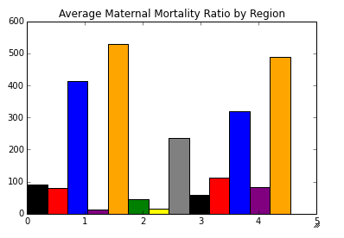
Health by Region
Northern Africa
Central America
South America
Western Africa
Eastern Africa
The Caribbean
Middle Africa
North America
Middle East
Southern Africa
Asia
Oceania
Europe

Slide 12
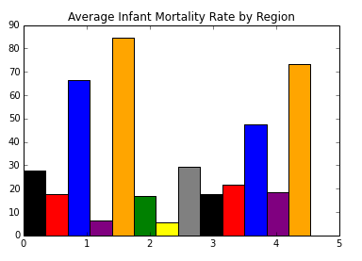
Health by Region
Northern Africa
Central America
South America
Asia
The Caribbean
Eastern Africa
Middle East
Middle Africa
Oceania
Western Africa
North America
Southern Africa
Europe

Slide 13
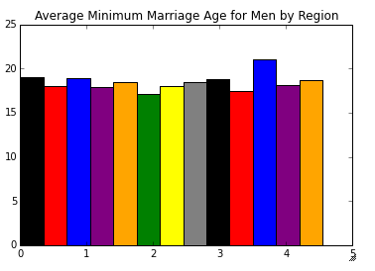
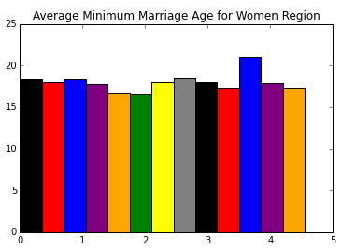
Families by Region
Southern Africa
Southern Africa
Central America
Central America
Middle East
Middle East
Eastern Africa
Oceania
Eastern Africa
Oceania
South America
South America
Northern Africa
Middle Africa
Northern Africa
Europe
Middle Africa
Europe
The Caribbean
The Caribbean
North America
Western Africa
North America
Western Africa
Asia
Asia

Slide 14
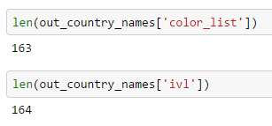
Clustering
Performed clustering on all 4 data sets
We were going to display the results on a map, however we ran into the following issue:

Slide 15
Families Clustering
Initially the data looked great! Europe looked almost completely clustered together
Then we realized that the data was looking mostly at minimum marriage age, which was very close in most countries, and identical in many

Slide 16
Education Clustering
Gave a few small clusters:
The Caribbean
Europe
Again, a lot of the data was very similar and we also lost a large number of countries

Slide 17
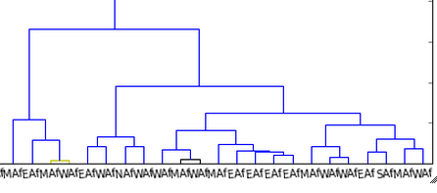


Health Clustering

Slide 18

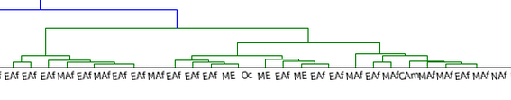
Population Clustering

Slide 19
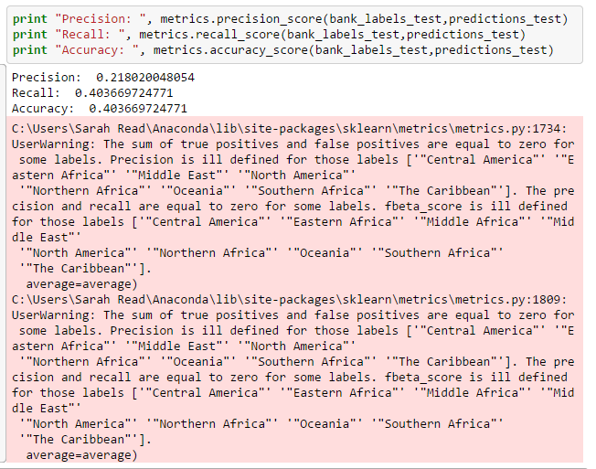
Decision Trees

Slide 20
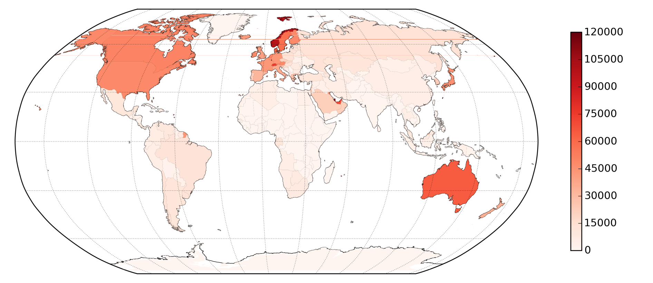
Visualizing GDP

Slide 21
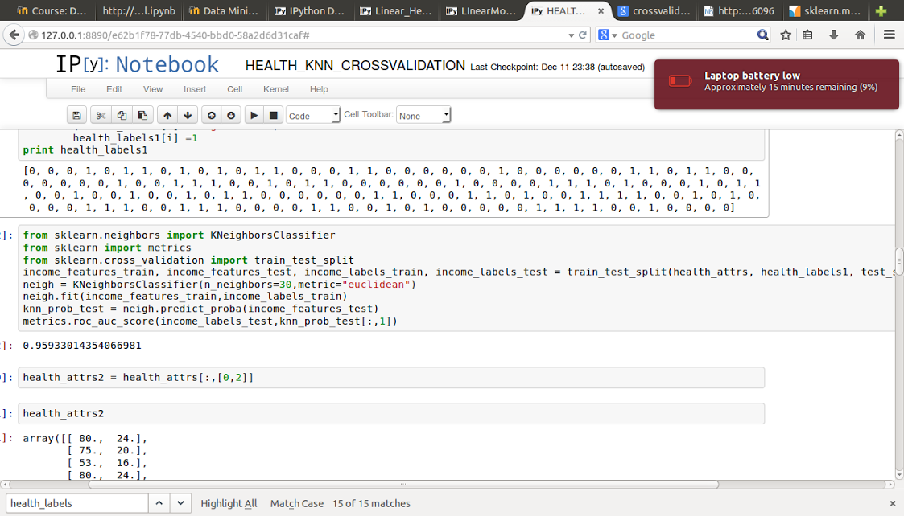
KNN - Health

Slide 22
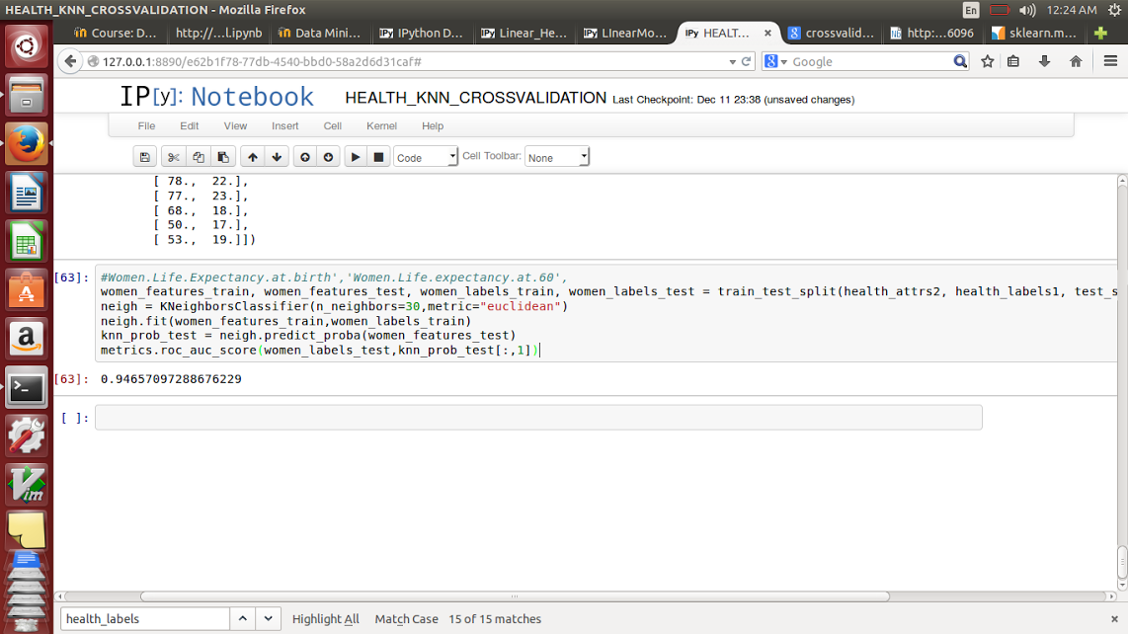
KNN - Health

Slide 23
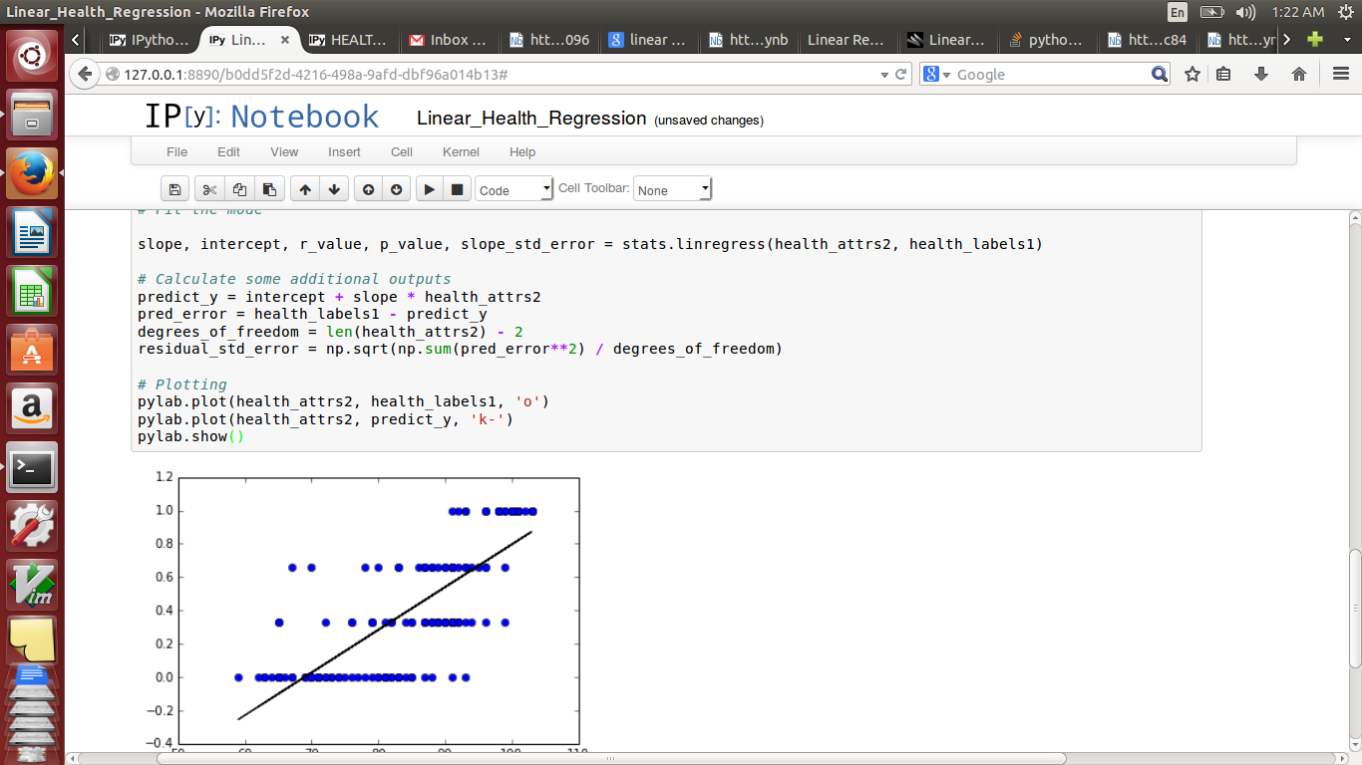
Basic Linear Regression

Slide 24
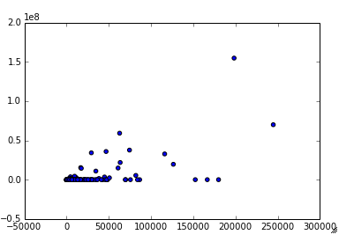
Twitter Data
About 190 countries
However, only 47 of them have more than 1,000 tweets associated with them
Asia: 7
Central America: 1
Europe: 30
North America: 2
Northern Africa: 1
South America: 5
Southern Africa: 1
Tweet Count vs. Population

Slide 25
Summary of our Findings
As a whole, Africa is severely behind the rest of the world regarding healthcare
However, you cannot define a country by it’s region
You can predict the income group based on the country’s health data

